Slide 1
ASSIGNMENT 1

Slide 2
TOPICS COVERED
What is
Central Tendency
Mean
Median
Mode
Variance
Standard Deviation

Slide 3
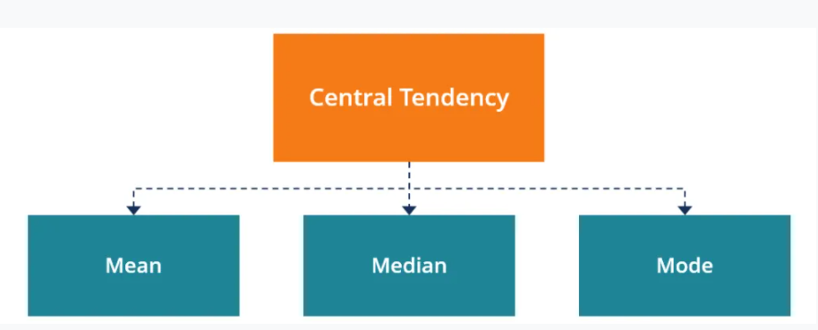
Measure of Central Tendancy
A measure of central tendency is a summary statistic that represents the center point or typical value of a dataset.
These measures indicate where most values in a distribution fall and are also referred to as the central location of a distribution.
The three most common measures of central tendency are the mean, median, and mode and each of these measures calculates the location of the central point using a different method.

Slide 4
Mean
Mean refers to an average value of a data set.
Mean can be calculated by adding all the data set and devide it by the total number of data set.
Example:
[2,5,3,7,10,3]
2 + 5 + 3 + 7 + 10 + 3 = 30
30 / 6 = 5
Means tells that most of the number in data set is around the mean value.

Slide 5
Median
Median refers to the middle most value of a data set.
Median can be calculated by arranging the data set from lowest to highest sequence and then select the middle most value.
Example 1 :
[2,5,3,7,10,3,8]
[2,3,3,5,7,8,10]
Median = 5
Example 2 :
[2,5,3,7,10,3,8,11]
[2,3,3,5,7,8,10,11]
5 + 7 = 12
12/2 = 6

Slide 6
Mode
Mode refers to to the most occured value in a data set.
In some cases, a dataset may contain multiple modes while some datasets may not have any mode at all.
Example :
[2,5,3,7,10,3,2,7,11,9,7,10,12,14]
Mode = 7

Slide 7
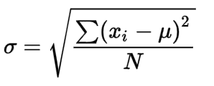
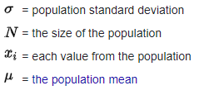
Standard Deviation & Variance
The standard deviation is a measure of the amount of variation or dispersion of a set of values.
Standard Deviation is calculated as the square root of variance by determining each data point's deviation relative to the mean.
If the data points are further from the mean, there is a higher deviation within the data set; thus, the more spread out the data, the higher the standard deviation.

Slide 8
Calculating the Standard Deviation
Standard deviation is calculated as follows:
The mean value is calculated by adding all the data points and dividing by the number of data points.
The variance for each data point is calculated by subtracting the mean from the value of the data point. Each of those resulting values is then squared and the results summed. The result is then divided by the number of data points.
The square root of the variance—result from the above point is then used to find the standard deviation.

Slide 9
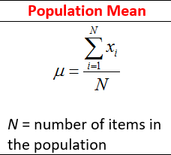
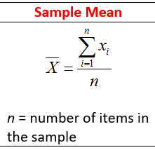
Population Mean
Sample Mean
Population mean represents the actual mean of the whole population.
The population mean is represented by the Greek letter mu (μ).
Formula to calculate population mean.
Sample mean is the arithmetic mean of random sample values drawn from the population.
The sample mean is represented by x bar.
Formula to calculate sample mean.

Slide 10
Find Mean, median, mode and standard deviation for each data set.
a) [7,11,16, 14, 11, 13, 19, 13,13]
Mean = 13
Median = 13
Mode 13
Variance = 10
S.D = 3.162

Slide 11
b) [16, 15, 16, 17, 19, 12, 14, 9]
Mean = 14.75
Median = 15.5
Mode = 16
Variance = 8.437
S.D. = 2.904

Slide 12
c) [27, 66, 24, 81, 50, 40, 74, 81, 97]
Mean = 60
Median = 66
Mode = 81
Variance = 596.4
S.D. = 24.42

